Slide 1
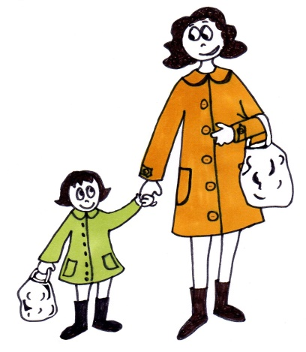
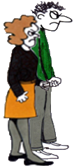
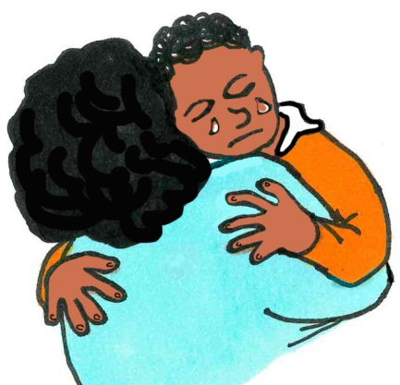
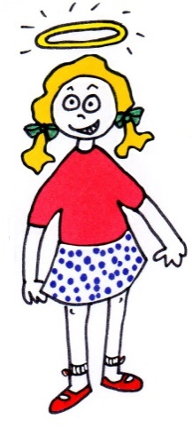
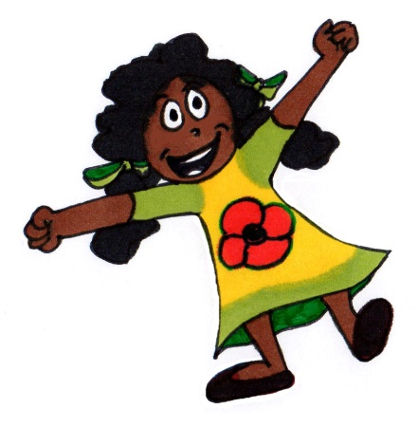
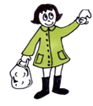
EGO STATES (original Eric Berne)
Parent
P
Critical
Parent
Nurturing
Parent
Adult
Adult
C
Child
Adapted Child
Free
Child

Slide 2
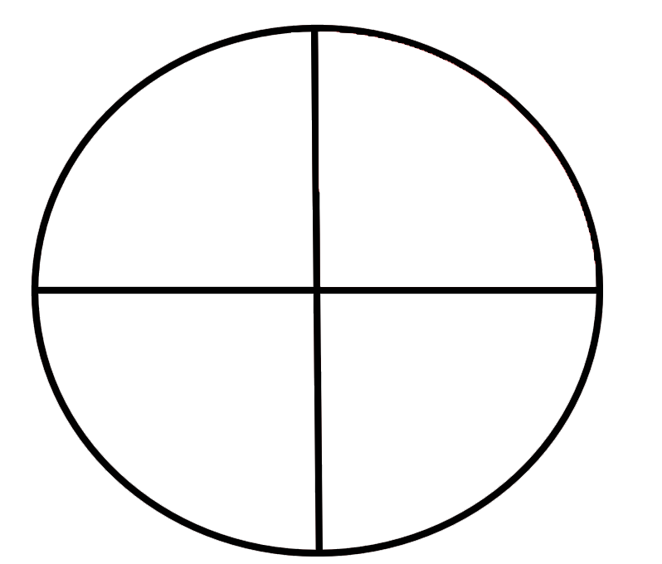
BEING “IN”….
What is needed for healthy development,
to feel safe and secure, and that we belong?
STRUCTURE
LOVING DISCIPLINE
LOVE
ACCEPTANCE
Structuring Parent
Nurturing Parent
IN
Socially
Adapted child
Free Child
SOCIAL ADAPTATION
EMPATHY
FREEDOM
SELF WORTH

Slide 3
THE CIRCLE OF BELONGING
You can learn – and it’s ok to make mistakes!
You are loved and
you are ok!
Structuring Parent
Nurturing Parent
Socialised Child
Free Child
I understand the rules,
I am empathic
I am worthy of love, just as I am!

Slide 4
INTERNALISED SECURE SELF-TALK
Internalised SP
It’s ok to make mistakes – we all do. You can learn!
Internalised NP
You are loved and you are ok! Be kind to yourself
Internalised SAC
Be kind to others - you know how it feels
Internalised FC
You are worthy of love – enjoy being you!

Slide 5
INTERNALISED INSECURE SELF-TALK
Critical Parent
You’ll be in big trouble if you get it wrong!
Lack of NP
Do what people want and they will like you
Adapted Child
Watch out for yourself
Lack of FC
I can’t be the real me.
WHERE DOES THIS COME FROM?

Slide 6
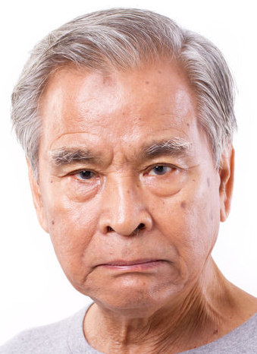
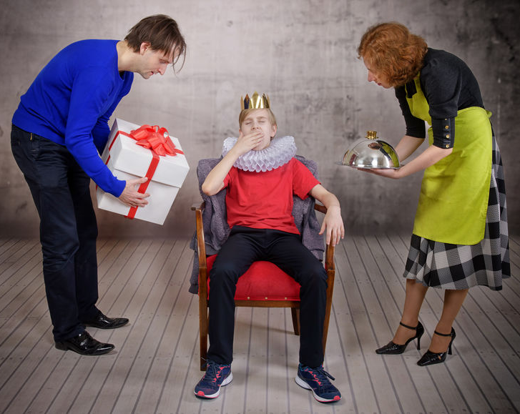
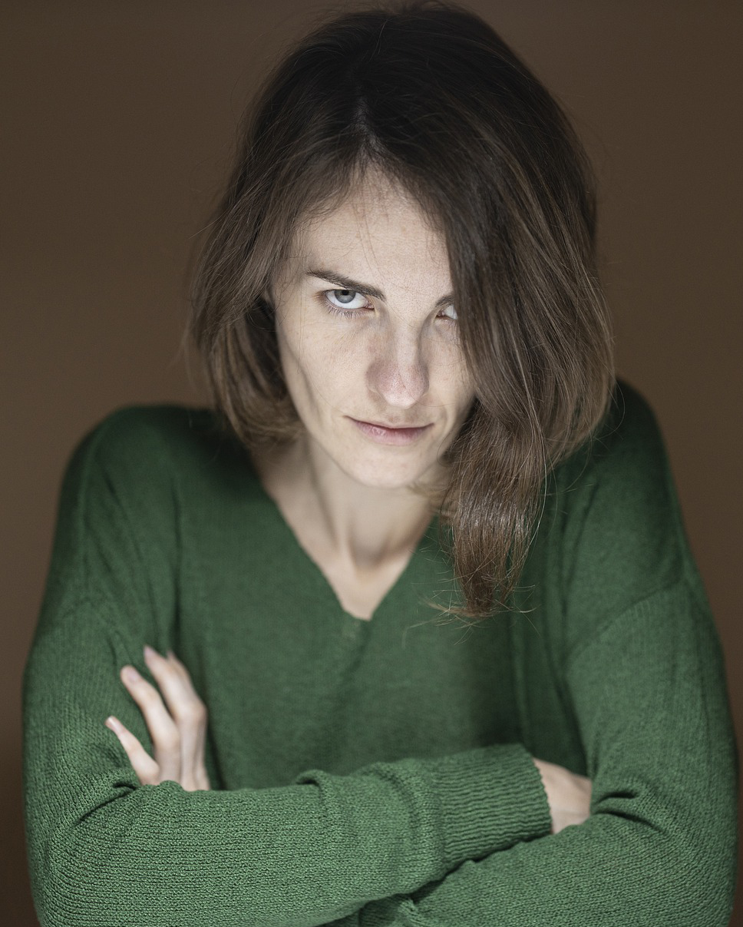
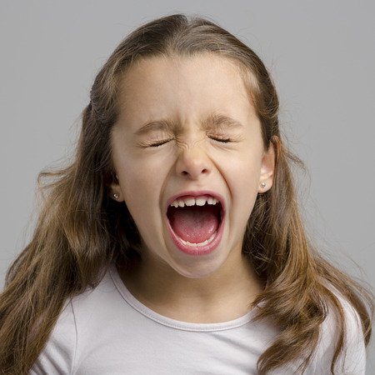
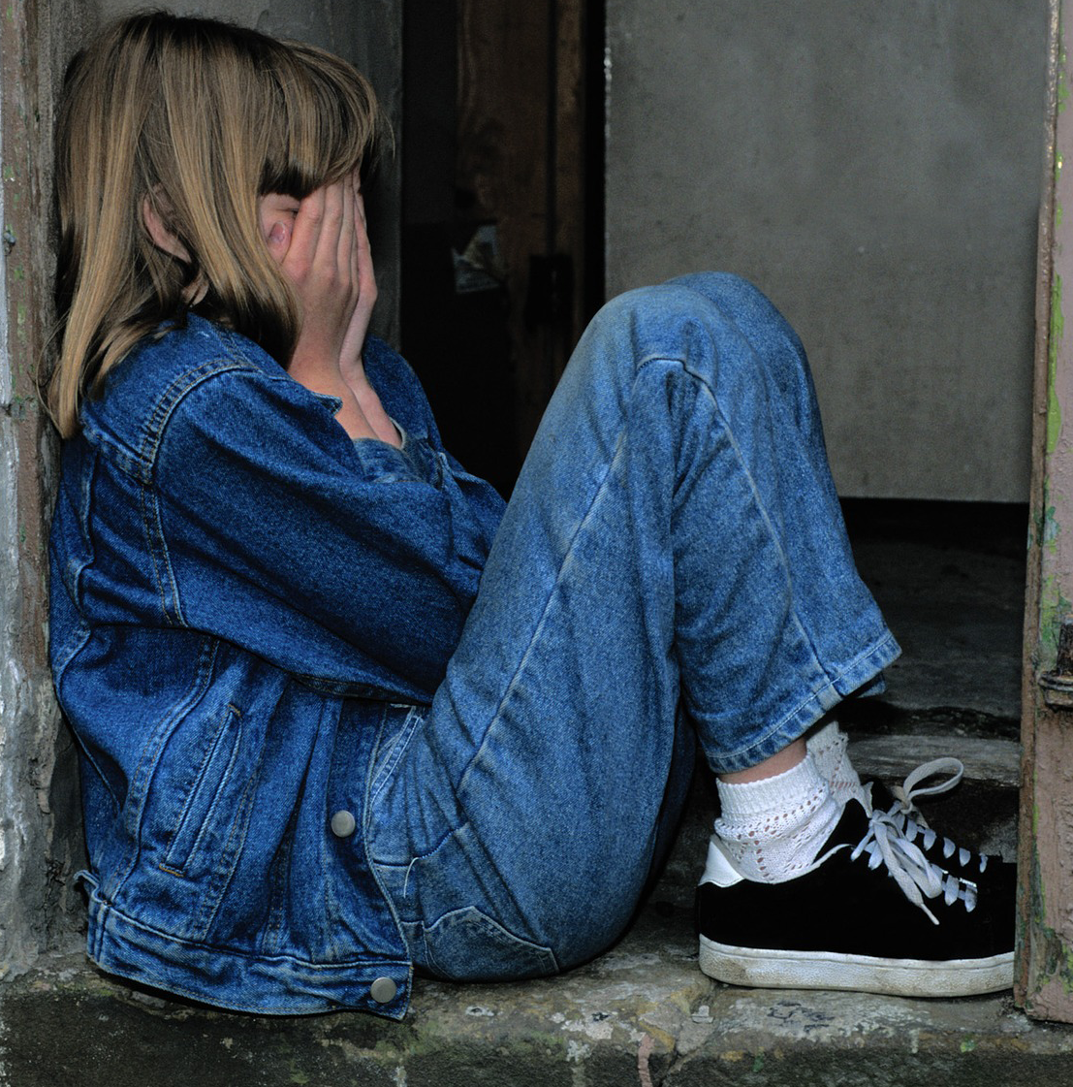
Inconsistent Parent
Critical, Controlling
Abusive Parent
Permissive Parent
OUT
IN
OUT
Adapted Child
Conditional Love
Wild Rebel Child
Hurt Child
Hurt – Shame - Anger - Rebellion

Slide 7
MESSAGES WE HEAR IN OUR HEAD WHEN WE ARE “OUT”
Conditional love
“Behave – be good”
Poor Boundaries
“Do / have what you want”
OUT
OUT
I must
get it right
Don’t tell me what to do!
I am afraid of being punished

Slide 8
LOSSES
Conditional love
“Behave – be good”
Poor Boundaries
“Do / have what you want”
I must
get it right
Don’t tell me what to do!
I am afraid of being punished

Slide 9
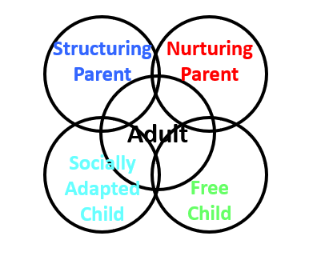
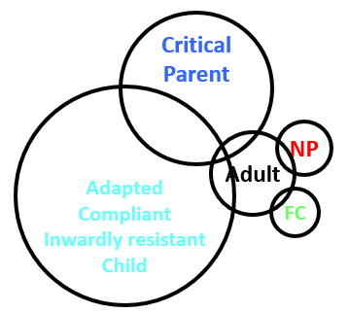
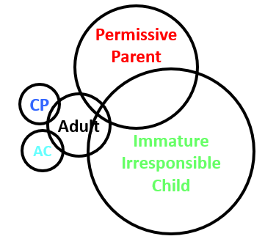
EGOGRAMS
Balanced, integrated,
mature, healthy
Rigid, uptight, conformist
critical, perfectionist
Self-indulgent, wild, carefree, disinhibited - a liability!

Slide 10
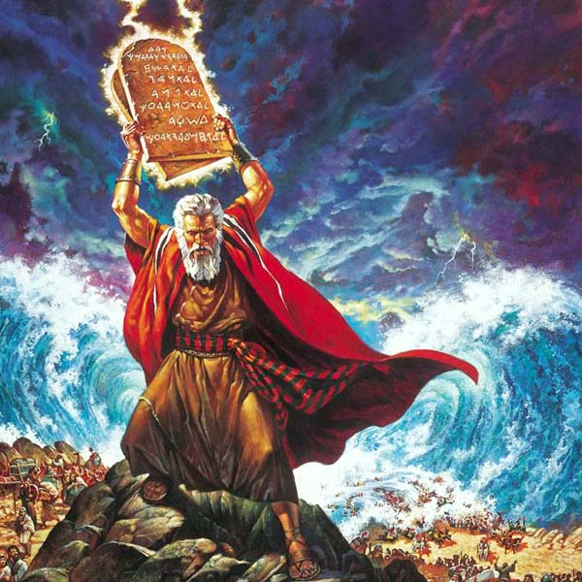
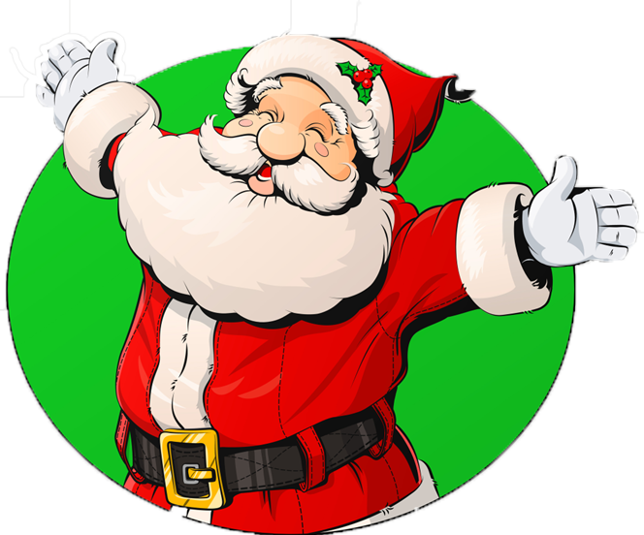
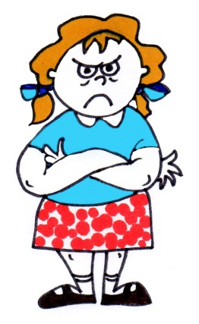
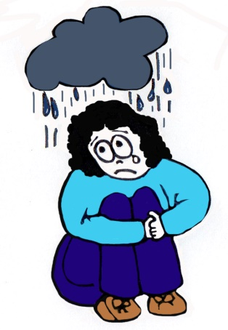
THE IN-OUT MODEL AND FAITH
Structuring Parent
Nurturing Parent
Socialised Child
Free Child
Why didn’t you give me what I wanted?
I’m such a failure

Slide 11
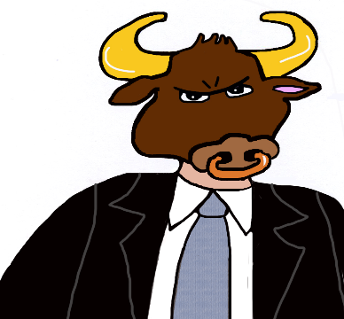
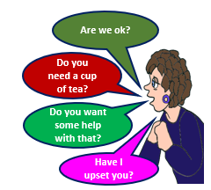
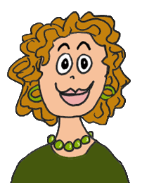
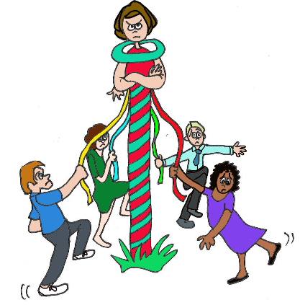
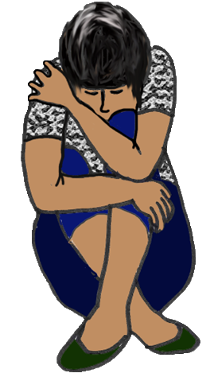
THE IN-OUT MODEL AND ROLES PLAYED IN GROUPS
Bully Group Leader
Over-Nurturing
Structuring Parent
Nurturing Parent
I hate this group, I want to hide
Socialised Child
Free Child
Dance Round Me
Try Too Hard

Slide 12
THE IN-OUT MODEL AND COUNSELLING
Hears
CRITICAL, CONTROLLING PARENT
I will need to charge you for your late cancellation…
STRUCTURING PARENT
She doesn’t care about me… I’m not special to her…

