Slide 1
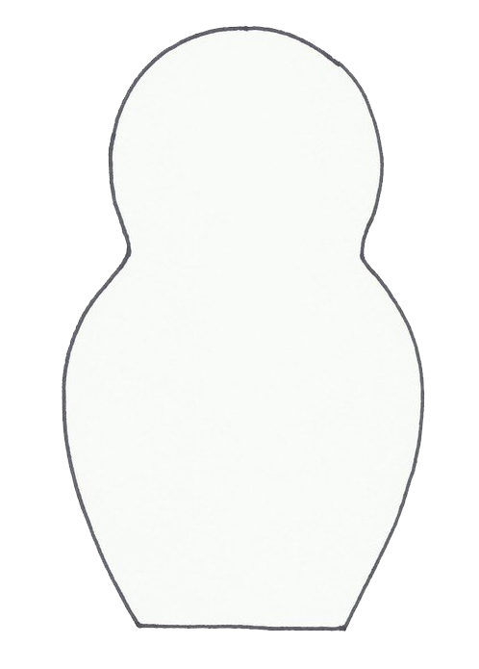
USING NESTING DOLLS : TIME TO REFLECT

